Slide 1

University College of Engineering BIT Campus Tiruchirappalli.
Real Time Vision Based Anti-Poaching Detection System
PRESENTED BY
Mohamed Farhaan N (810022104076)
Karthickeyan T (810022104113)
GUIDED BY
Dr. C. USHARANI
Department of Computer
Science and Engineering

Slide 2
AIM
To develop a vision-based anti-poaching detection system using a custom CNN to automatically identify human presence in forest areas from video footage. The system distinguishes humans from animals and generates alerts to support automated wildlife monitoring with pretrained models.
Need for System
Automated monitoring
Real-time detection
Reduced manual effort
Faster response

Slide 3
PROBLEM STATEMENT
Wildlife poaching is a major threat to biodiversity and endangered species. Forest monitoring is mostly done manually, which has several challenges:
Large forest areas are difficult to monitor continuously
Limited forest guards and patrol resources
Delayed detection of illegal human intrusion
Lack of automated real-time surveillance systems
Difficulty distinguishing humans from animals in video feeds
The absence of intelligent monitoring systems results in delayed response and increased wildlife crime.

Slide 4
OBJECTIVES
The objectives of the proposed system are:
To develop a custom CNN model for human detection
To differentiate humans from animals in forest footage
To provide real-time alert notifications
To reduce wildlife poaching activities
To automate forest surveillance without pretrained models
To improve response time of forest authorities

Slide 5
EXISTING SYSTEM
M-STrIPES (Monitoring System for Tigers)
M-STrIPES is a GPS-based patrol and ecological monitoring system developed by the National Tiger Conservation Authority (NTCA), Government of India.
It is currently used in many Indian tiger reserves for:
Recording patrol routes using GPS-enabled devices
Monitoring tiger movement and habitat conditions
Collecting ecological and field data
Tracking wildlife crime incidents

Slide 6
LIMITATIONS OF EXISTING SYSTEM
Although M-STrIPES improves patrol documentation,
it has several limitations:
No real-time human intrusion detection
Does not automatically analyze live video footage
No AI-based human vs animal classification
Detection depends on physical patrol presence

Slide 7
PROPOSED SYSTEM
The proposed system is a Vision-Basedf Anti-Poaching Detection System that uses a custom Convolutional Neural Network (CNN) model to detect human presence in forest areas.
Key Features:
Real-time human detection
Human vs Animal classification
Automated alert generation
Custom-built CNN model
Continuous surveillance support
Scalable monitoring system

Slide 8
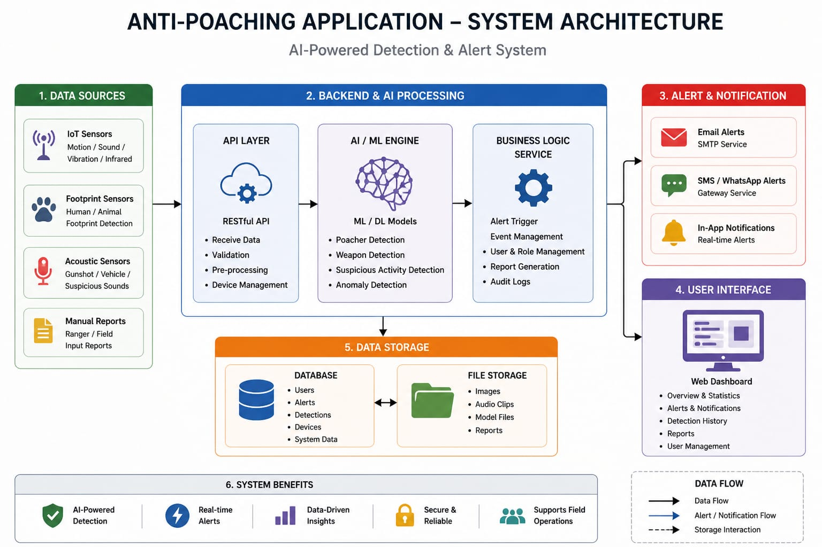
SYSTEM ARCHITECTURE

Slide 9
METHODOLOGY – CORE ALGORITHM
Convolutional Neural Network (CNN)- YOLO V8
Convolutional Neural Networks (CNNs) were initially used in the system to classify images as human or animal by extracting features through convolution layers, reducing dimensions using pooling layers, and performing classification with fully connected layers, where softmax activation produced the final prediction. However, the approach has been enhanced by adopting YOLOv8, which replaces the traditional CNN classification pipeline with a unified object detection model. YOLOv8 performs feature extraction, localization, and classification in a single step, enabling faster and more accurate real-time detection of humans and animals directly from video streams.

Slide 10
METHODOLOGY – ALGORITHM WORKING
Frame Extraction Algorithm
Extract frames from video using OpenCV.
Image Resizing Algorithm
Bilinear interpolation resizes an image by estimating a new pixel value using the weighted average of its four nearest neighboring pixels.
Contrast Enhancement Algorithm
HOG extracts the distribution of edge directions (gradients) in image regions.
Classification Module
Softmax converts raw output scores into normalized probability values across multiple classes using an exponential function.

Slide 11
MODULES
Video Processing Module Extracts frames from live video streams.
Image Preprocessing Module Resizes, normalizes, and prepares images for CNN.
Human Detection Module Uses custom CNN to classify humans and animals.
Alert Module Sends alerts if human intrusion is detected.
Admin Dashboard Module Displays logs, detection history, and system performance.

Slide 12
TECHNOLOGIES USED
Programming Language: Python, Kotlin Frameworks/Libraries: Ultralytics, OpenCV Database: MySQL (for storing logs and alerts) IDE: VS Code / PyCharm Operating System: Windows / Linux
Dataset: Custom dataset containing forest images of humans and animals for
training and testing.

Slide 13
CONCLUSION & FUTURE WORK
This project presented an AI-based Anti-Poaching Detection System, a smart wildlife monitoring solution that integrates real-time surveillance with deep learning for detecting illegal activities in forest environments. While traditional monitoring methods are slow and unreliable, the proposed system leverages artificial intelligence to automate detection and improve response time. Challenges such as delayed identification, human error, and lack of continuous monitoring were addressed through an intelligent detection pipeline using models like YOLOv8. The implementation demonstrates that AI-based systems can act as proactive monitoring tools rather than passive recording systems.
Future Enhancements
Night vision support
Drone integration
Improved dataset training
Real-time forest dashboard

Slide 14
REFERENCES
Jocher, G., Chaurasia, A. and Qiu, J. (2023) ‘Ultralytics YOLOv8’, Ultralytics Documentation, pp.
1–50.
2. Wang, C.-Y., Bochkovskiy, A. and Liao, H.-Y.M. (2023) ‘YOLOv7: Trainable Bag-of-Freebies Sets New State-of-the-Art for Real-Time Object Detectors’, IEEE Conference on Computer Vision and Pattern Recognition (CVPR), pp. 7464–7475.
3. Li, Y., Zhang, X. and Chen, H. (2023) ‘Real-Time Object Detection in Complex Environments Using Deep Learning’, IEEE Access, Vol. 11, pp. 11234–11245.
4. Kumar, A. and Singh, R. (2023) ‘AI-Based Wildlife Monitoring System Using Computer Vision’, International Journal of Advanced Computer Science and Applications, Vol. 14, No. 2, pp. 210–218.
5. Chen, L., Wu, D. and Zhao, Y. (2024) ‘Deep Learning-Based Surveillance for Wildlife Protection’, IEEE Transactions on Intelligent Systems, Vol. 39, No. 1, pp. 55–67.

Slide 15
THANK YOU

